Slide 1
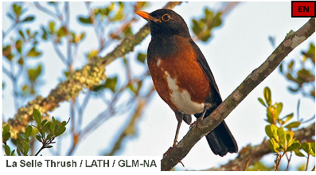
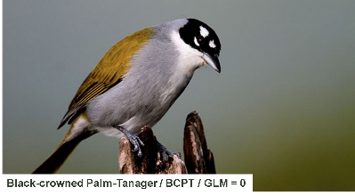
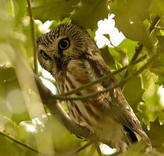
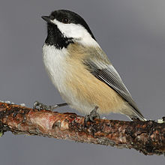
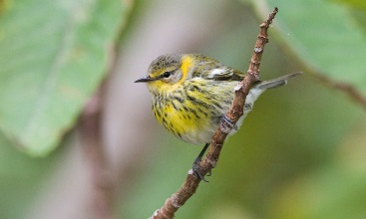
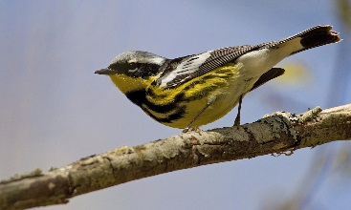
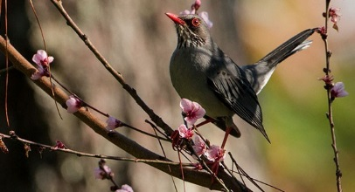
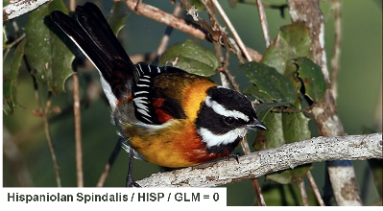
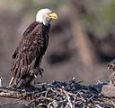
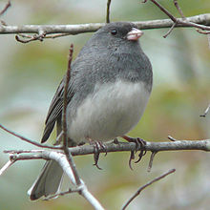
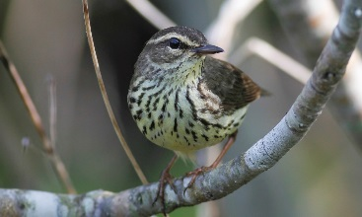
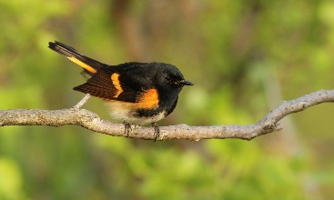
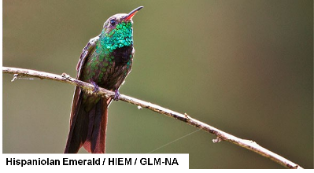
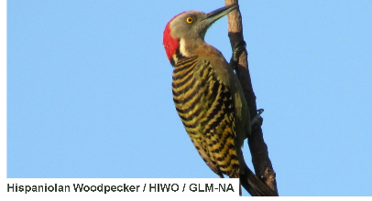
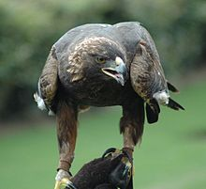
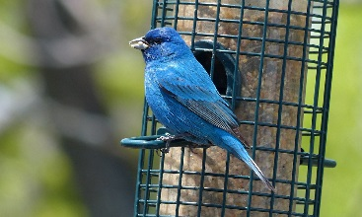
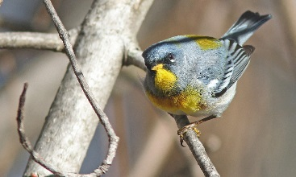
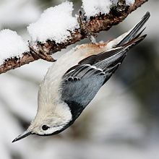
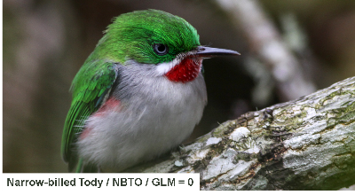
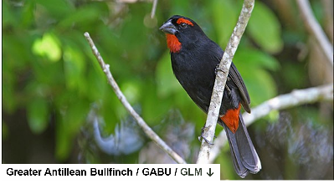
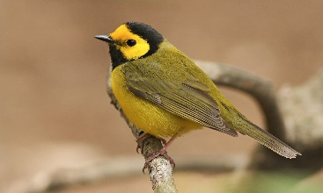
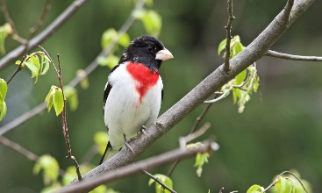
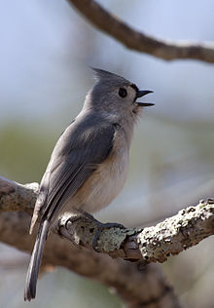
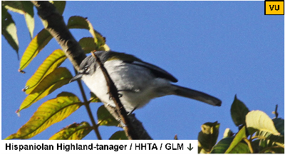
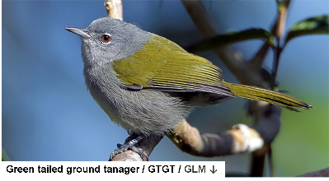
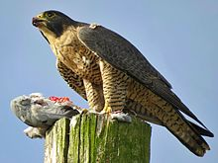
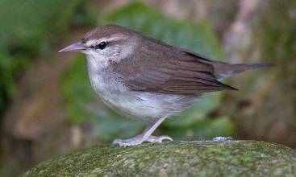
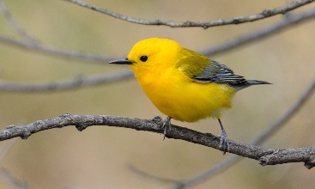
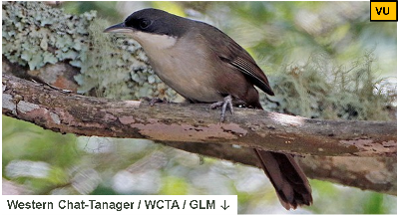
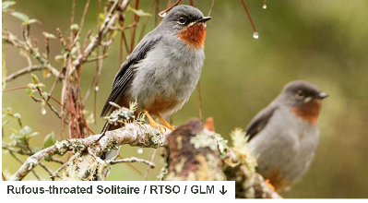
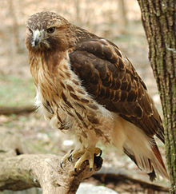
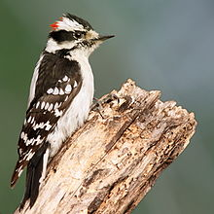
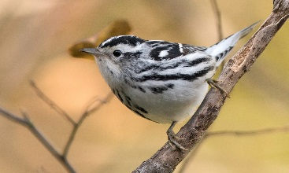
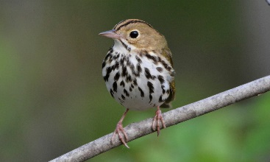
Introduction to Avian Ecology & the “Wild Bird Project”
Nathan Brouwer, PhD
La Roche University &
National Aviary

Slide 2
Lecture outline
1) Birds!
resident vs. migrants
2) Bird habitat:
nesting, breeding, wintering
3) Damage to bird habitat:
degradation, fragmentation, loss
4) Bird Predators:
Nest predation vs. “on the wing”
Habitat fragmentation & nest predation
Native & Introduced (cats!)
5) Bird Diseases:
Pathogens, parasites & zooenoses
Parasites & Habitat framentation
Parasites & predation
Other hazards:
windows & windfarms

Slide 3
1)Birds!

Slide 4
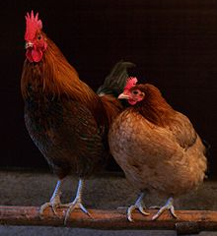
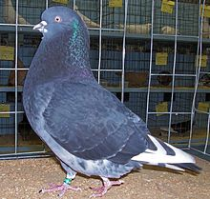
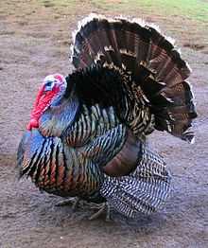
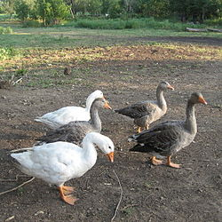
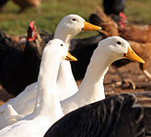
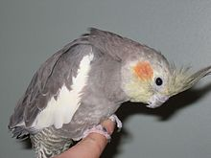
Birds!
Domestic Birds
Wild Birds

Slide 5
Wild Birds!
Residents
Stay in about the same place all year
Migrants
Move between breeding habitat & wintering habitat

Slide 6
Migrant Birds!
Short- to medium-Distance migrants
Move around on the same continent
Long-distance migrants
Move between continents / landmasses

Slide 7
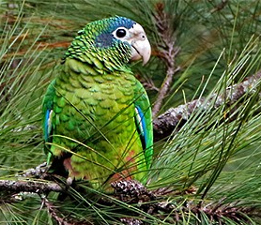
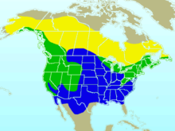
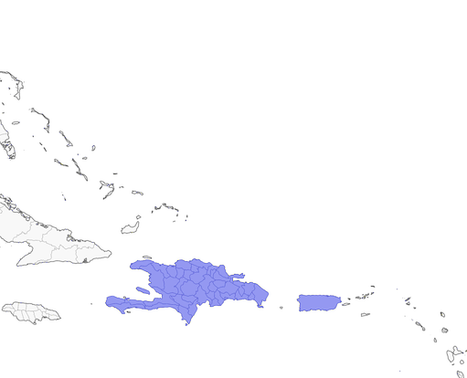
A species’ geographic range
Hispanolean Parrot
Tropical Resident
Dark-eyed Junco
N American short/med- distance migrant
Breeding
Year-round
Winter

Slide 8
A species’ geographic range
Hispanolean Parrot
Tropical Resident
Dark-eyed Junco
N American short/med- distance migrant
Breeding
Year-round
Winter

Slide 9
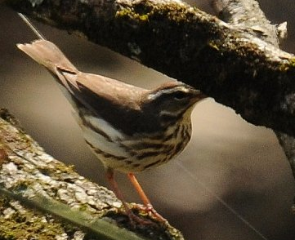
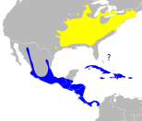
A species’ geographic range
Louisianna Waterthrush
Long-distance Neotropical migrant

Slide 10
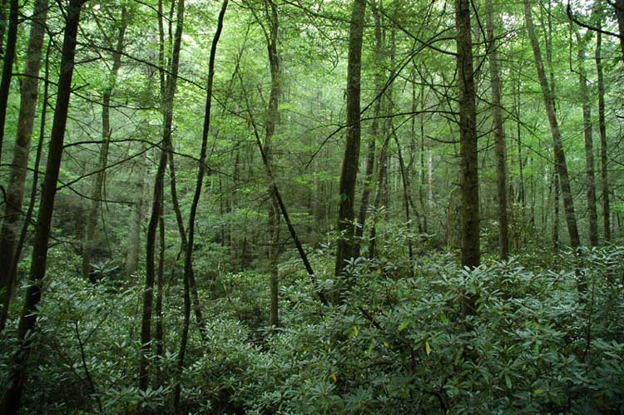
2) Bird Habitat

Slide 11
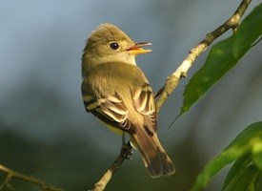
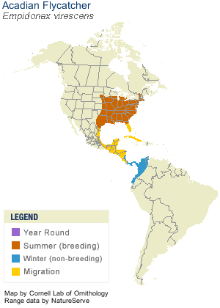
Bird Habitat
Summer habitat
Breeding habitat
Nesting Habitat

Slide 12
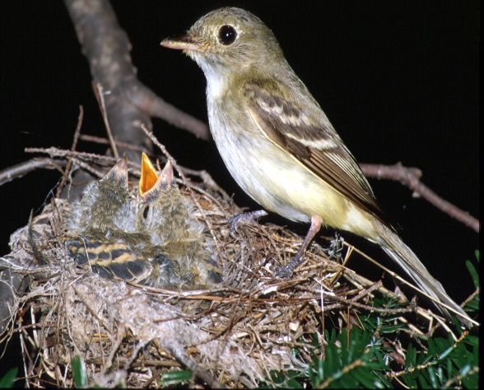
Bird Habitat
Summer habitat
Breeding habitat
Nesting Habitat
Notes:
See work by Scott Stohlson in Auk about use of edge habitats; also general research on habitat use differences between nesting and fledglings

Slide 13
Bird Habitat
Summer habitat
Breeding habitat
Species are often very specific about where they breed in the summer…
Nesting Habitat
Wintering Habitat

Slide 14
Bird Habitat
Breeding
Migratory stopover
Winter

Slide 15
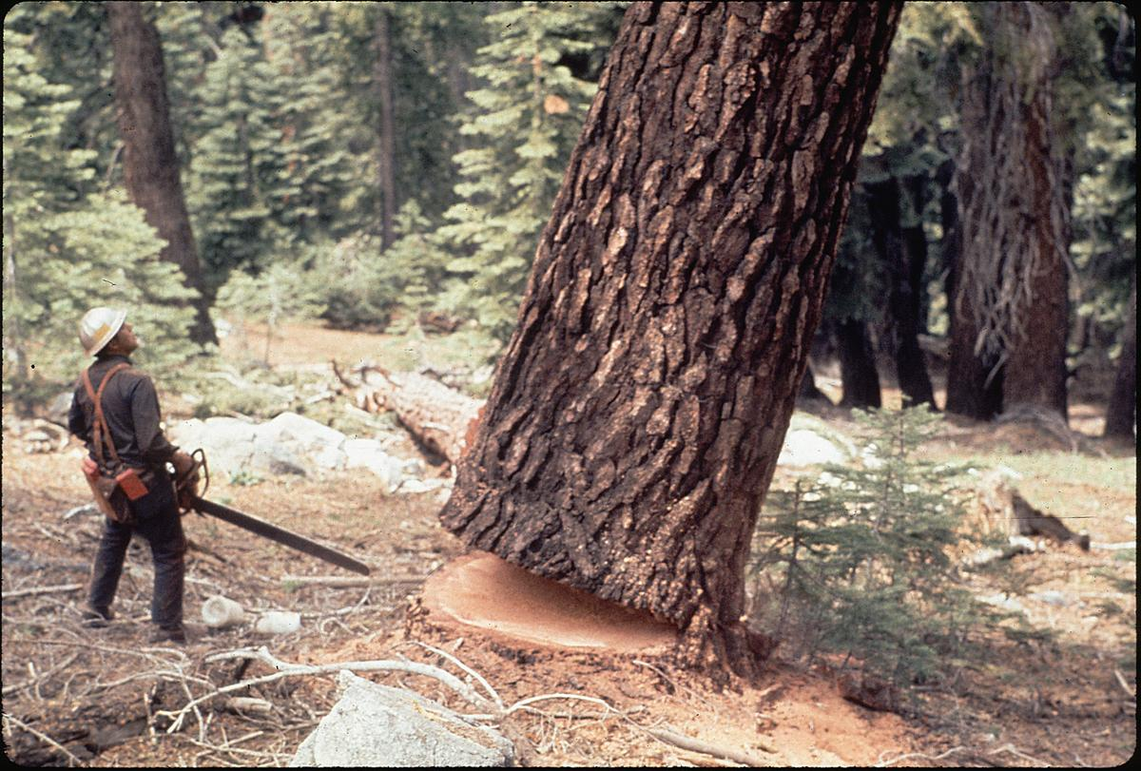
3) Damage to bird habitat:

Slide 16
Damage to Bird Habitat
Degradation
Fragmentation
Loss
Reduction in the quality of habitat
-More predators
-Fewer resources
-Can occur w/o obvious changes to the structure of habitat
Reduction in the size, connectivity, or integrity of habitat
-Forest divided into smaller patches by logging
-Roads in forest
Reduction in the amount or extant of habitat, often by harvest or conversion to another land use
-Forest logged for timber & then converted to farm

Slide 17
Damage to Bird Habitat
Degradation
Fragmentation
Loss
Reduction in the quality of habitat
Makes it less hospitable.
-More predators
-Fewer resources
-Can occur w/o obvious changes to the structure of habitat
Reduction in the size, connectivity, or integrity of habitat
-Forest divided into smaller patches by logging
-Roads in forest
Reduction in the amount or extant of habitat, often by harvest or conversion to another land use
-Forest logged for timber & then converted to farm

Slide 18


Damage to Bird Habitat
Degradation
High quality stream
Acidic stream

Slide 19

Damage to Bird Habitat
Fragmentation
Contiguous / In-tact forest
Forest fragments / patches
Forest Edge

Slide 20
Damage to Bird Habitat
Fragmentation
Contiguous / In-tact forest
Reduction in the size, connectivity, or integrity of habitat
Forest fragments / patches
Forest Edge

Slide 21
Forest fragmentation
Interior
Edge
Matrix
Gap
Edge
Forest fragments / patches

Slide 22
Forest fragmentation
Interior
Edge
Matrix
Gap
Edge
Forest fragments / patches

Slide 23


Forest fragmentation by roads

Slide 24

4) Bird Predators:

Slide 25



Predation on Birds
Nest predation
Predation “on the wing”
Eggs or
nestlings
Incubating female
Fledglings / Juveniles
Adults
Notes:
https://www.allaboutbirds.org/how-can-i-protect-the-baby-birds-in-a-nest-from-predatory-birds-and-other-predators-like-snakes-and-cats/

Slide 26



Nest predation
Bear
Mice?
Snakes Raccoons
Mice Cats
Other birds (!)
Deer (!) Bears (!!)
Raccoons
Notes:
http://www.mirror.co.uk/news/world-news/watch-bear-climb-electricity-pylon-5832795

Slide 27


Predation “on the wing”
Adults
Fledglings / Juveniles

Slide 28


Predation “on the wing”

Slide 29

Nest predation & Habitat fragmentation
swift parrot
Sugar glider
Notes:
Sugar Glider
Figure 2: A sugar glider predation event captured by a camera trap at Region 2. The panel shows (a) an adult female swift parrot at her nest cavity at 1900 h, then (b) at 2300 h on the same day, a sugar glider entering the cavity, where it caused the failure of that nest. (c) Adult female swift parrots are killed and eaten by sugar gliders.

Slide 30


Fragmented
Notes:
Figure 3 Modelled daily survival rates (95% confidence
intervals) of mainland Tasmanian swift parrot nests as a
function of landscape-scale forest cover. Estimates were
generated using the parameters from the model of best fit and
show that DSR improved as regional forest cover increased. In
contrast, DSR was 1 for nests on islands where sugar gliders do
not occur (not illustrated). DSR, daily survival rate.

Slide 31

Introduced Predators

Slide 32


The feral cat “problem”

Slide 33


versus
Build them homes!
Get rid of them!

Slide 34
5) Bird diseases: Pathogens, Parasites & zooentic transmission

Slide 35

Pathogens vs. Parasites (in Ecology)
Pathogens
Parasite
Cause disease…
Ecological usage:
The really small stuff:
viruses,
bacteria,
fungi
Cause disease…
Ecological usage
Big stuff: “brood parasites”
Birds that they their eggs in another spp. nests!
Small to medium-sized stuff
“macroparasites”
can see w/ naked eye
worms, lice, fleas
“microparasite” – malaria,

Slide 36



Bird parasites
Ectoparasites
(outside of cells)
Endoparasites
(inside of cells)
Intracellular
-malaria
Mites, Fleas
-feathers
-legs
Intercellular
-intestinal
worms
Botflies
-burrow into skin
(yuck)
Giardia
Notes:
https://en.wikipedia.org/wiki/Giardia#/media/File:Giardia_lamblia_SEM_8698_lores.jpg
https://microbiology.usgs.gov/image_gallery_other_microbes_giemsa_blood_smear.html
Giemsa-stained blood smear Photo credit: USGS
Research Summary: Changes in Prevalence of Avian Malaria on the Alaka`i Plateau, Kaua`i: an Early Signal for Global Warming? (Carter T. Atkinson)

Slide 37



Known negative impacts of parasites
Palm warbler
Leg mites

Slide 38

Known negative impacts of parasites
No mites
Mites
Notes:
FIG. 1. Mean pectoral muscle scores (SE) of parasitized and nonparasitized Palm Warblers in two habitats (pine forest, desert thorn scrub) and three sampling periods (November, January, March). Birds were scored for pectoral muscle mass using a scale of 0–3 (0 = muscle concave and sternum prominent to 3 = muscle convex and sternum not detectable).

Slide 39
Known negative impacts of parasites
Mites negative impact bird “body condition” as measured by “pectoral muscle score”
No mites
Mites
Notes:
FIG. 1. Mean pectoral muscle scores (SE) of parasitized and nonparasitized Palm Warblers in two habitats (pine forest, desert thorn scrub) and three sampling periods (November, January, March). Birds were scored for pectoral muscle mass using a scale of 0–3 (0 = muscle concave and sternum prominent to 3 = muscle convex and sternum not detectable).

Slide 40
Known negative impacts of parasites
Mites negative impact bird “body condition” as measured by “pectoral muscle score”
No mites
Mites
Notes:
FIG. 1. Mean pectoral muscle scores (SE) of parasitized and nonparasitized Palm Warblers in two habitats (pine forest, desert thorn scrub) and three sampling periods (November, January, March). Birds were scored for pectoral muscle mass using a scale of 0–3 (0 = muscle concave and sternum prominent to 3 = muscle convex and sternum not detectable).

Slide 41


Avian Zooenoses:
diseases transmitted from birds to humans
Bird flu
West Nile Virus

Slide 42
Avian Zooenoses:
diseases transmitted from birds to humans
Bird flu
West Nile Virus

Slide 43
Do most parasites have negative impacts on their avian hosts??
Macroparasites
Microparasite
Mites, fleas, ticks, worms
Often have negative effects
Eg Malaria
Often no negative effects found

Slide 44
Are the impacts of microparasites hard to identify?
?
Does parasite infection change ecology processes like predation?

